Slide 1
IDC Digital Trends
David Stevens https://github.dxc.com/dstevens26/IDCTrends

Slide 2
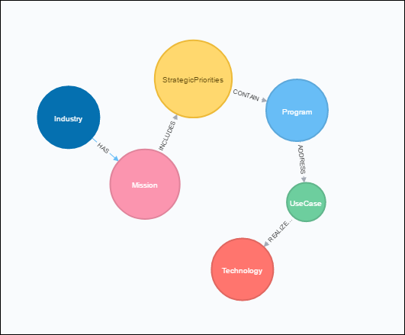
Schema
Simple import from IDC file
Reduced some content down to allow for grouping against common areas (e.g. Programs & Use Cases)

Slide 3
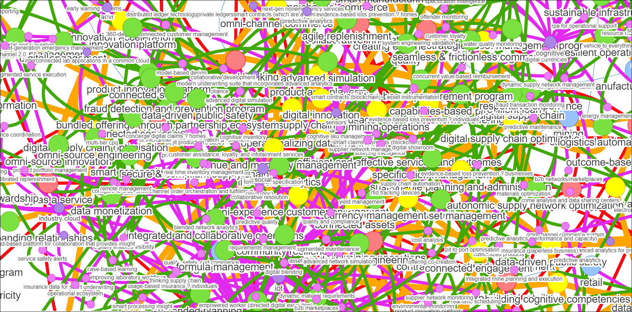
Industry > Mission > SP > Program
Arghh noise!
See next slides for a refinement on this overall view

Slide 4
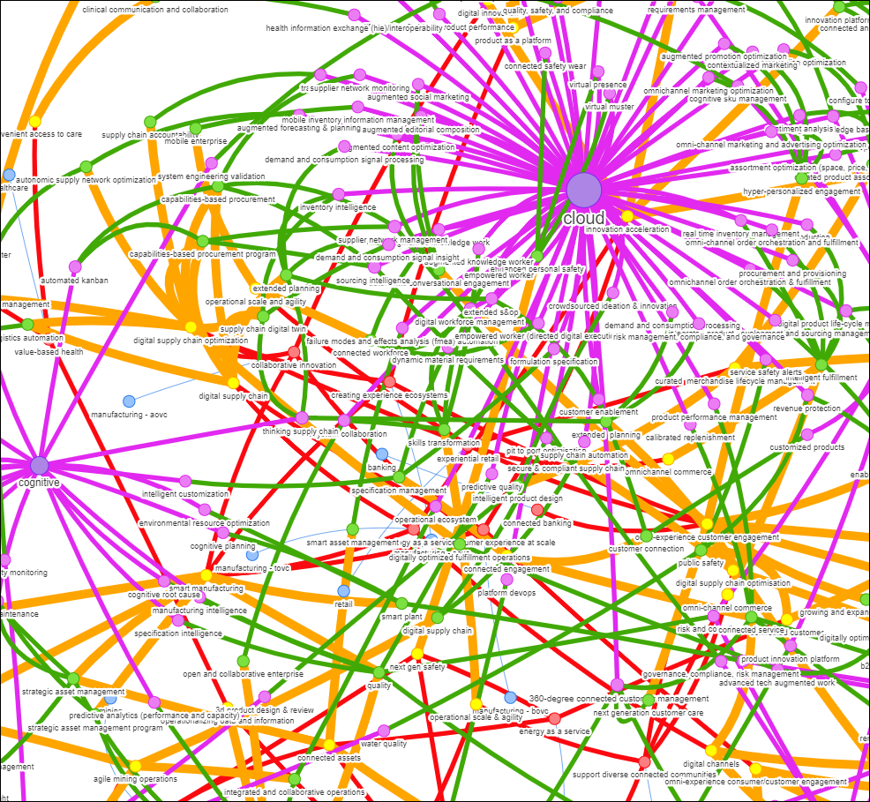
Industry > Mission > SP > Program
Showing top programs with the most technology connections

Slide 5
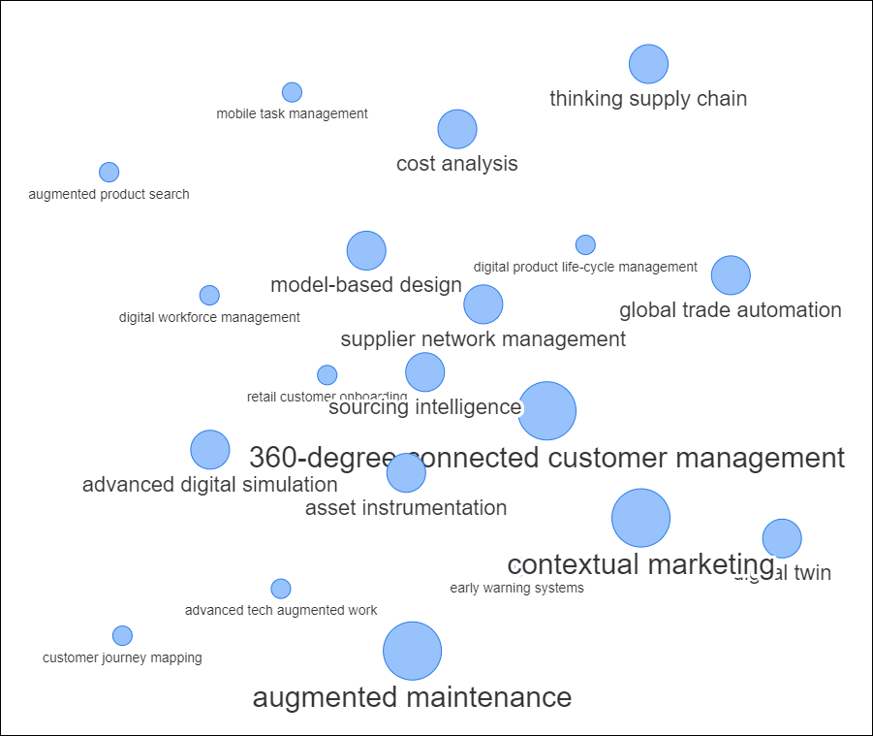
Most Common Use Cases
Use Cases with the most connections to a Program

Slide 6
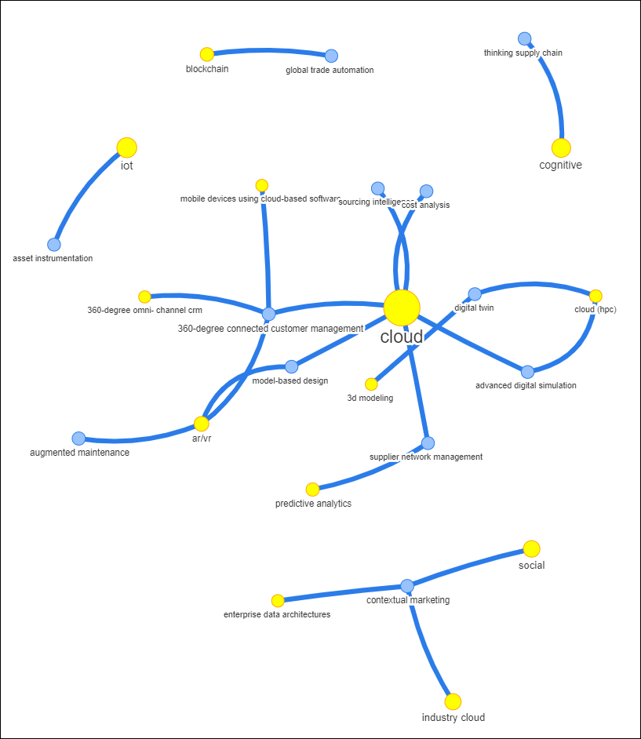
Most Common Use Cases & their technologies
Use Cases with the most connections to a Program and their enabling technologies

Slide 7
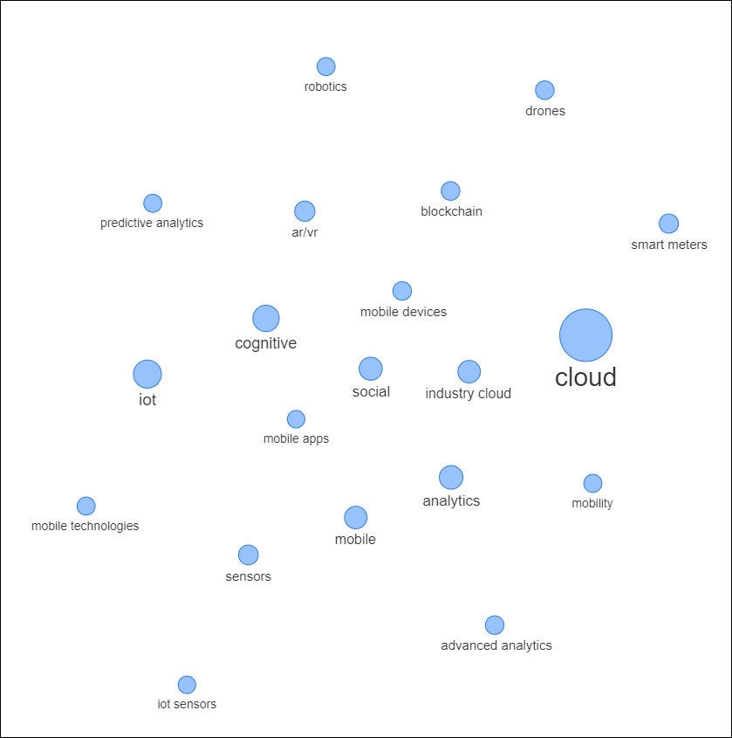
Most Common Technologies
Technologies with the most connected use cases

Slide 8
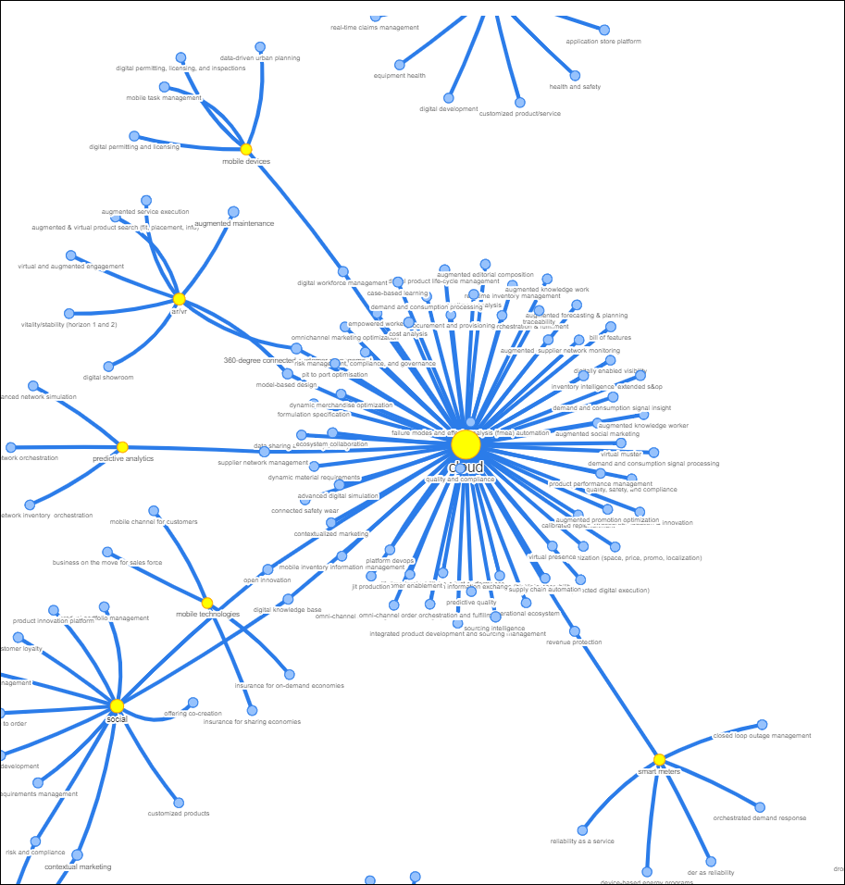
Most Common Technologies and their use cases
Technologies with the most connected use cases and their use cases

